Slide 1

Mathematical Foundations for Data Science
MFDS Team

Slide 2
DSECL ZC416, MFDS
Lecture No. 10

Slide 3
Agenda
Integral properties
  cdf and pdf
  Even and odd integrands
  Integration by parts
Partial derivatives and Directional derivatives
Vector calculus and some of the identities
Extremum in several variables
  Lagrange multipliers
  Method of steepest descent.

Slide 4


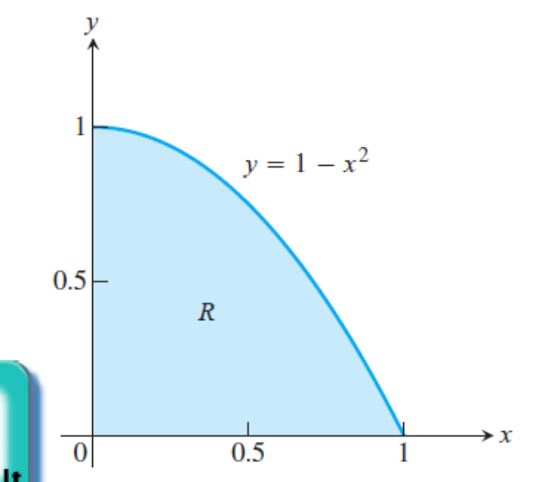
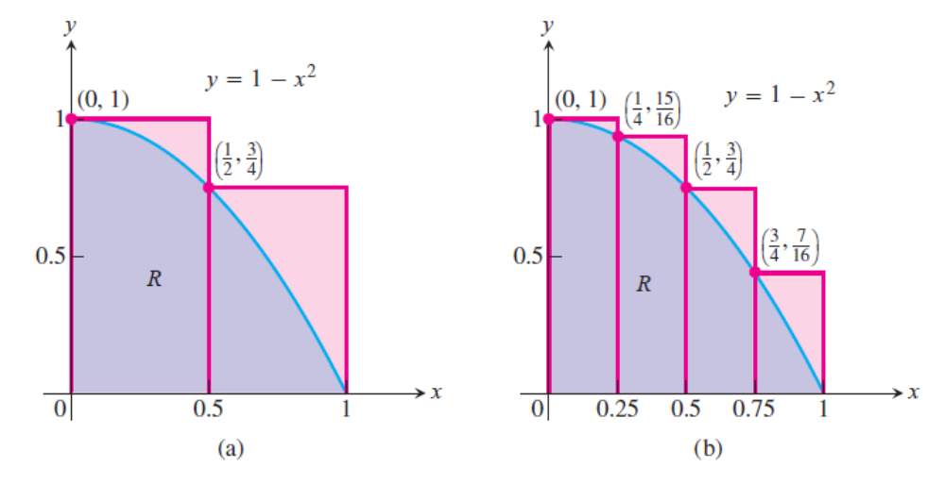
Properties of integrals
The idea behind integration is that we can effectively compute many quantities by breaking them into small pieces, and then summing the contributions from each small part.
Estimating with Finite Sums

Slide 5
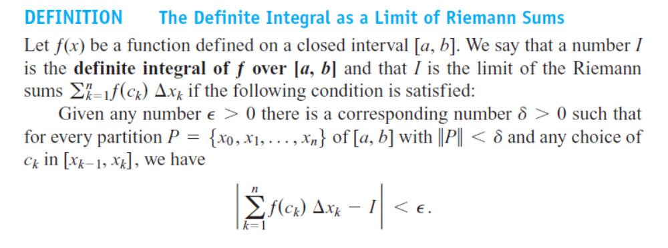
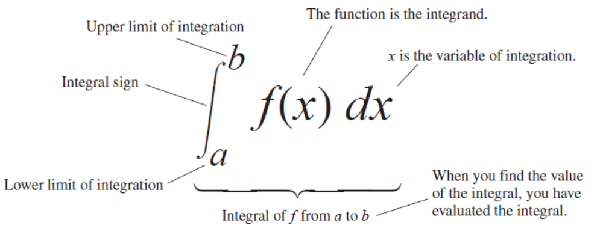
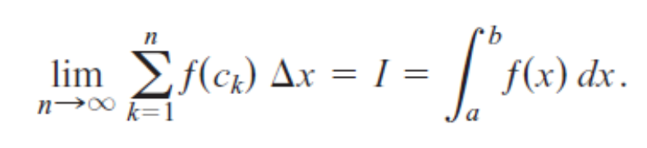
The Definite Integral

Slide 6
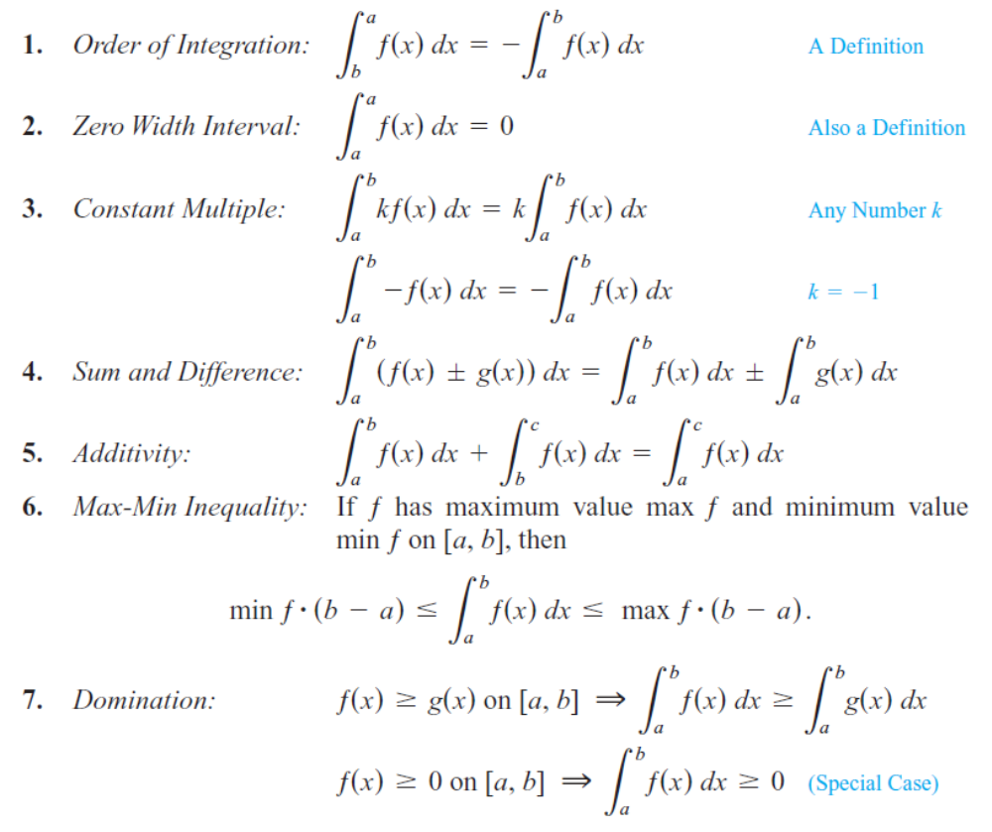
Properties of definite integrals

Slide 7
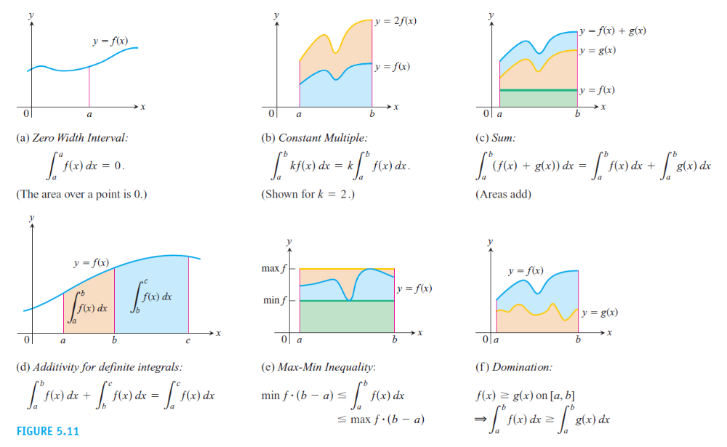
Properties

Slide 8
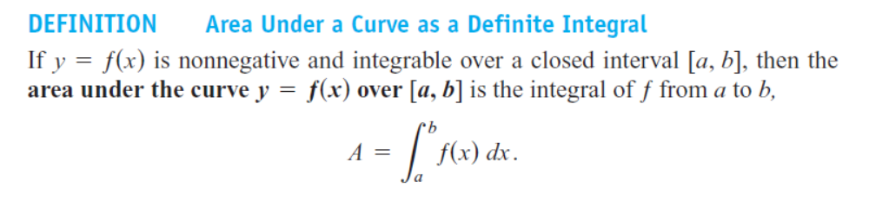
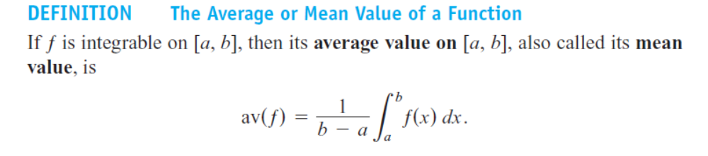
Properties

Slide 9
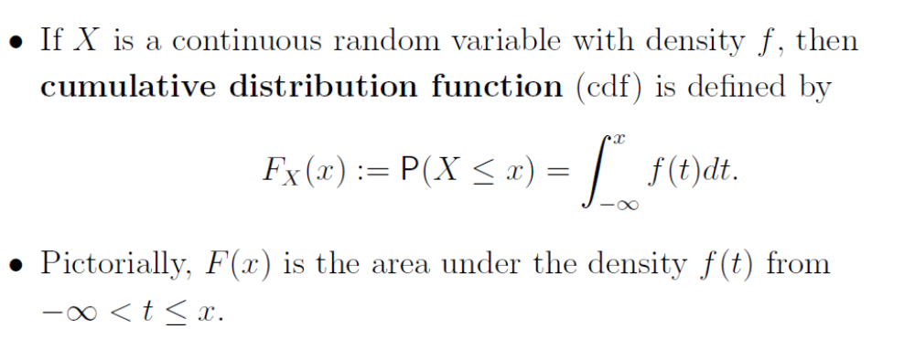
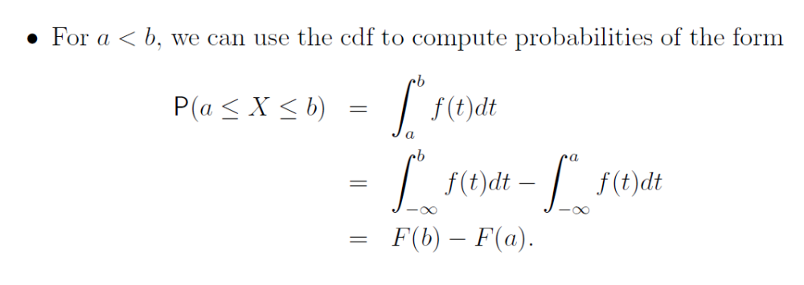
CDF and PDF

Slide 10
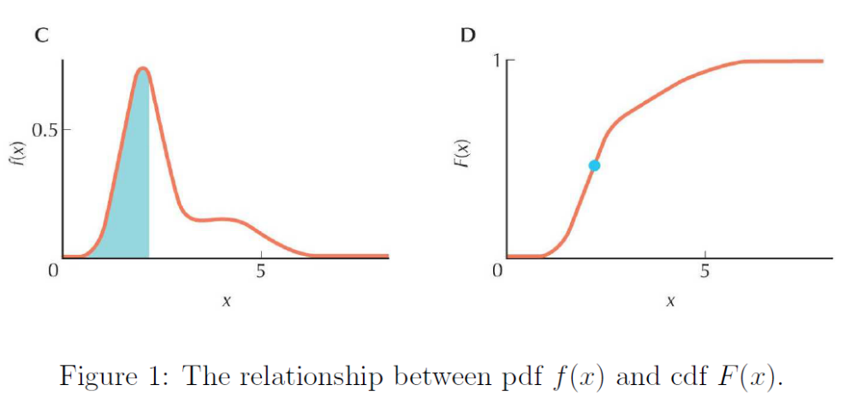
CDF and PDF

Slide 11
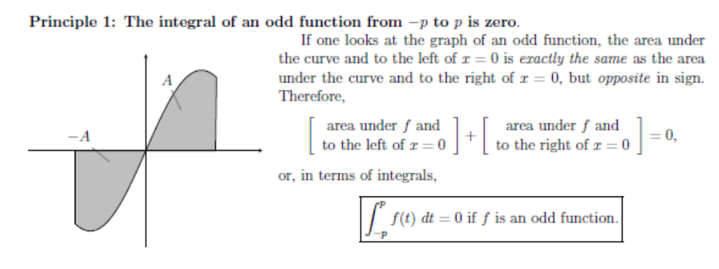
Even and odd integrands

Slide 12
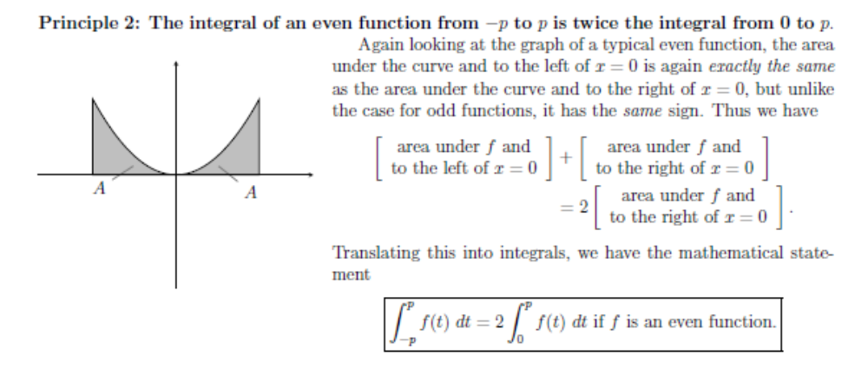
Even and odd integrands

Slide 13
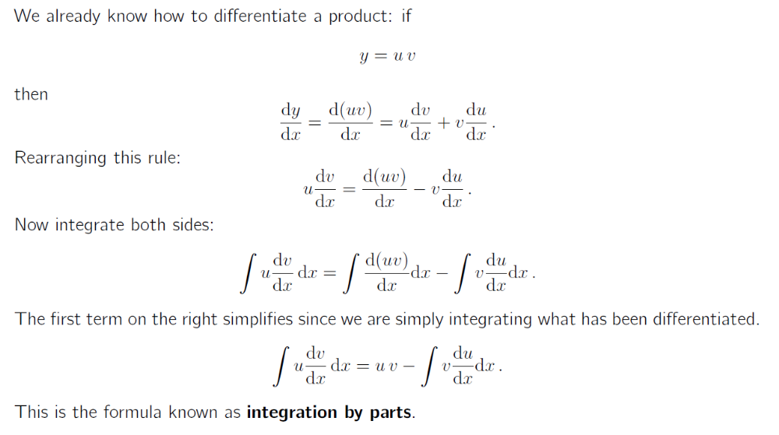
Integration by parts

Slide 14

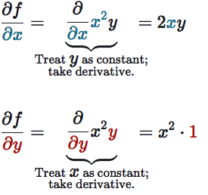
Partial Derivative
When input of function is made up of multiple variables, we want to see how function changes as we let just one of those variable change while holding all the others constant
f is a multivariable function
Tiny change in functions output
Tiny change in x

Slide 15
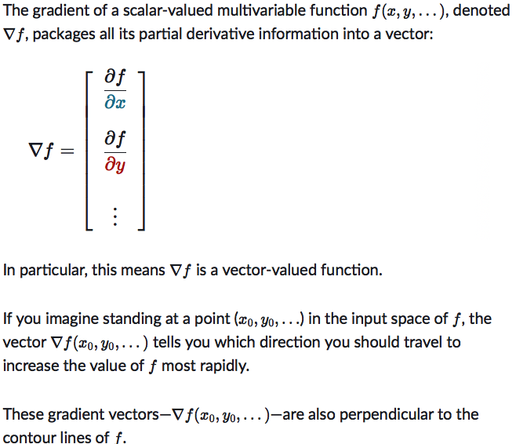
Gradient

Slide 16
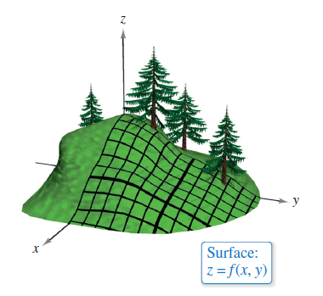
Directional Derivatives
You are standing on the hillside represented by z = f (x,y) in Figure and want to determine the hill’s incline toward the z- axis.
The slope in the y-direction would be given by the partial derivative f_{y}(x, y), and the slope in the x-direction would be given by the partial derivative f_{x}(x, y).
These two partial derivatives can be used to find the slope in any direction.

Slide 17
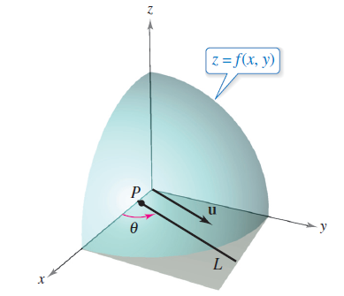
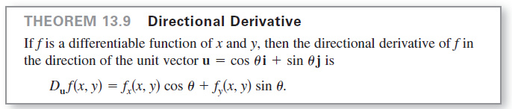
Directional derivatives
To determine the slope at a point on a surface, you will define a new type of derivative called a directional derivative.
Let z = f(x, y) be a surface and P(x₀, y₀) be a
point in the domain of f, as shown in Figure.
The “direction” of the directional derivative is
given by a unit vector u = cos θ i + sin θ j where θ is the angle
the vector makes with the positive x-axis.

Slide 18
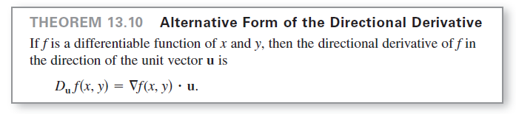
Directional Derivative
Because the gradient of f is a vector, you can write the directional derivative of f in the direction of u as
In other words, the directional derivative is the dot product of the gradient and the direction vector.

Slide 19


Hessian Matrix
Square matrix which is a way of organizing all second order partial derivative information of a multivariable function
Hessian matrix is always symmetric matrix →entries of the matrix are symmetric across its main diagonal
Define D(x,y) to be the determinant
Note : We expect the eigenvalues of the Hessian to be positive at local minimum
and negative at local maximum
If the Hessian has both positive and negative eigen values the corresponding point must be saddle point

Slide 20
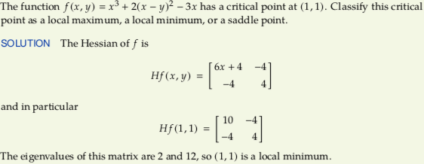
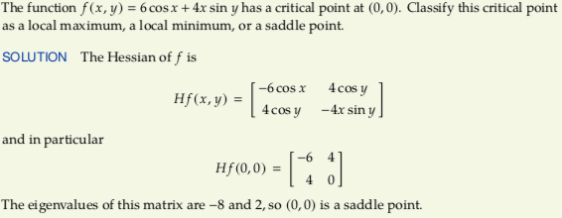
Hessian Matrix

Slide 21
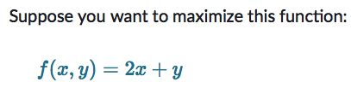
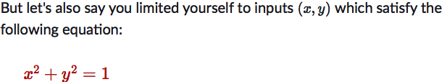
Lagrange Multiplier
Constrained Optimization problem
Lagrange Multiplier is developed to figure out the maxima/minima of an objective function f under a constraint function g
Core Idea : Look for points where the contour lines of f and g are tangent to each other
Function that needs to be optimized
Constraint
For which point (x,y) on the unit circle is the value 2x +y biggest?

Slide 22
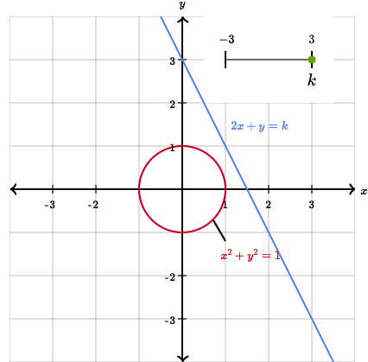
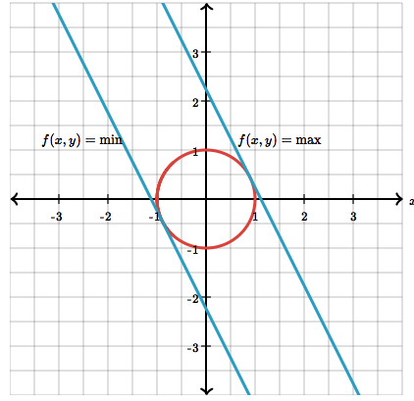
Lagrange Multiplier
First draw the graph of f(x,y) which looks like slanted plane since f is linear.
Then project the circle x² ⁺ y² = 1 from xy plane vertically onto the graph of f
Maximum we are seeking corresponds with highest point of this projected circle on the graph

Slide 23
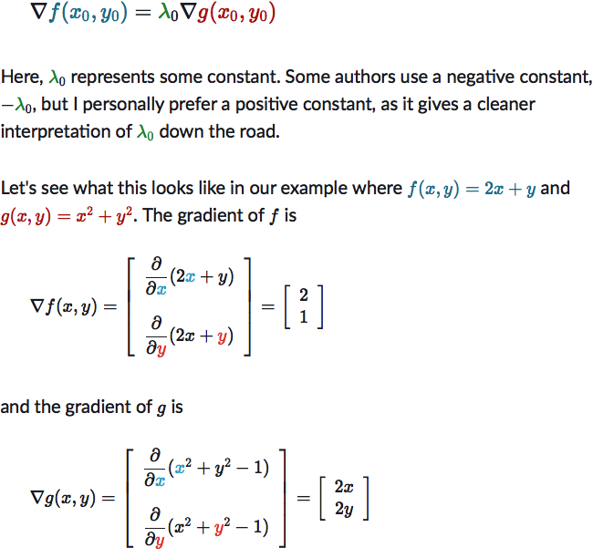
Lagrange Multiplier

Slide 24
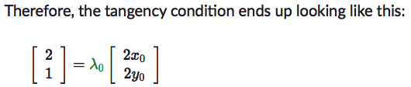


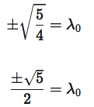

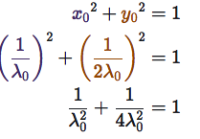
Lagrange Multiplier
Three Equations and three unknowns

Slide 25
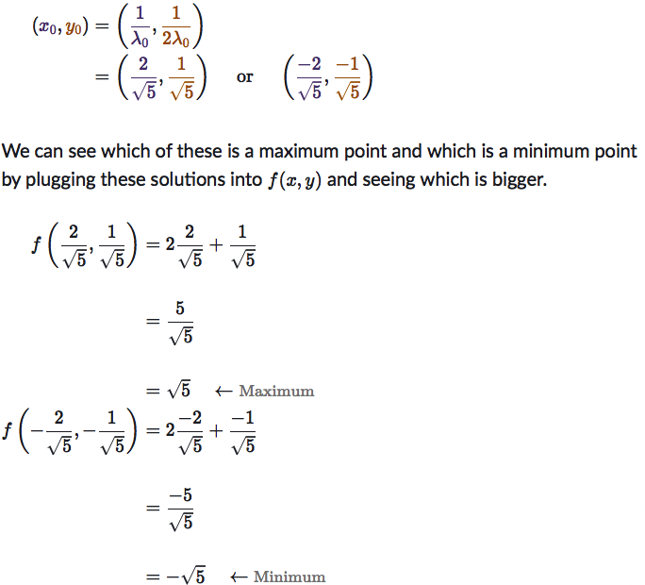
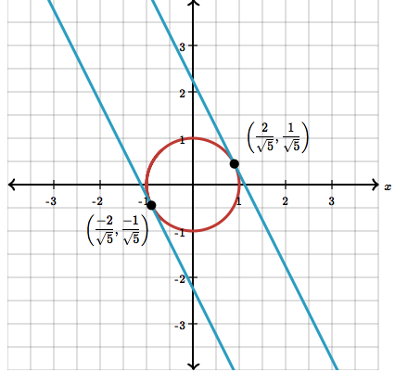
Lagrange Multiplier

Slide 26
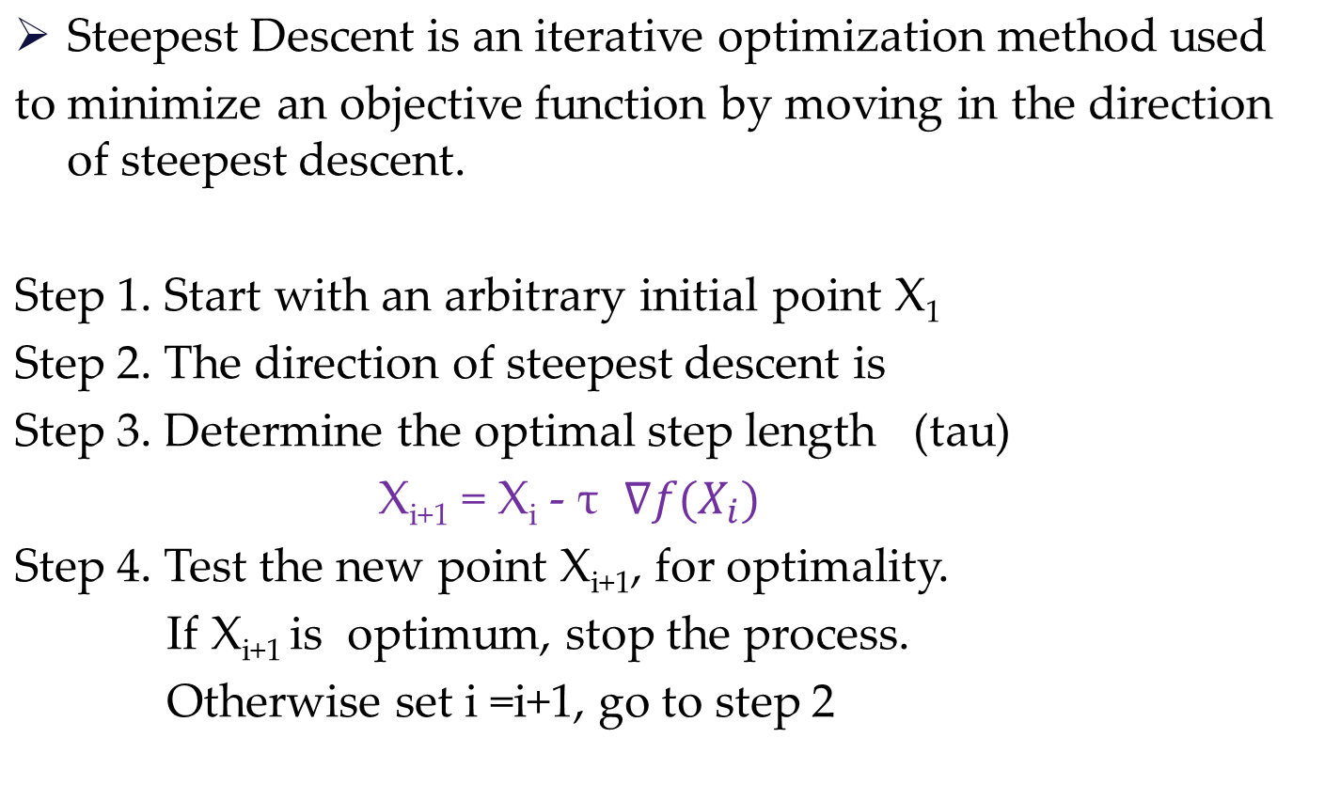


Method of Steepest Descent

Slide 27
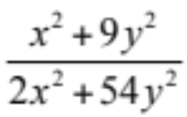
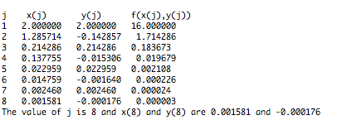
Method of Steepest Descent
Minimize Z = x² + 3y² starting from (2,2)
In this case, =

